Slide 1
Azure Data Platform End-to-End Implement a Modern Data Platform Architecture
<Presenter Name>
<Presenter Title>
<presenter@email.com>

Slide 2
Begin with the end in mind

Slide 3
Course Objectives
We will understand Cloud and Big Data concepts and technologies used to solve the most common advanced analytics problems
We will understand the role of Microsoft Azure data services in a modern data platform architecture
We will look at individual Azure Data Services and use them to implement a modern data platform reference architecture
We will have a ARM template of a data platform that will enable us to solve most of our data challenges

Slide 4
Important Reminder
The modern data platform architecture proposed in this course aims to help with your technology decisions when architecting data solutions in Azure.
The Azure services covered in this course are only a subset of a much larger family of data services. Some real-world data scenarios may require the use of services not included in this course.
This course does not replace in-depth training on each Azure service covered today.
Some concepts presented in this course can be quite complex and you may need to seek for more information from different sources.

Slide 5
Modern Data Platform Reference Architecture

Slide 6
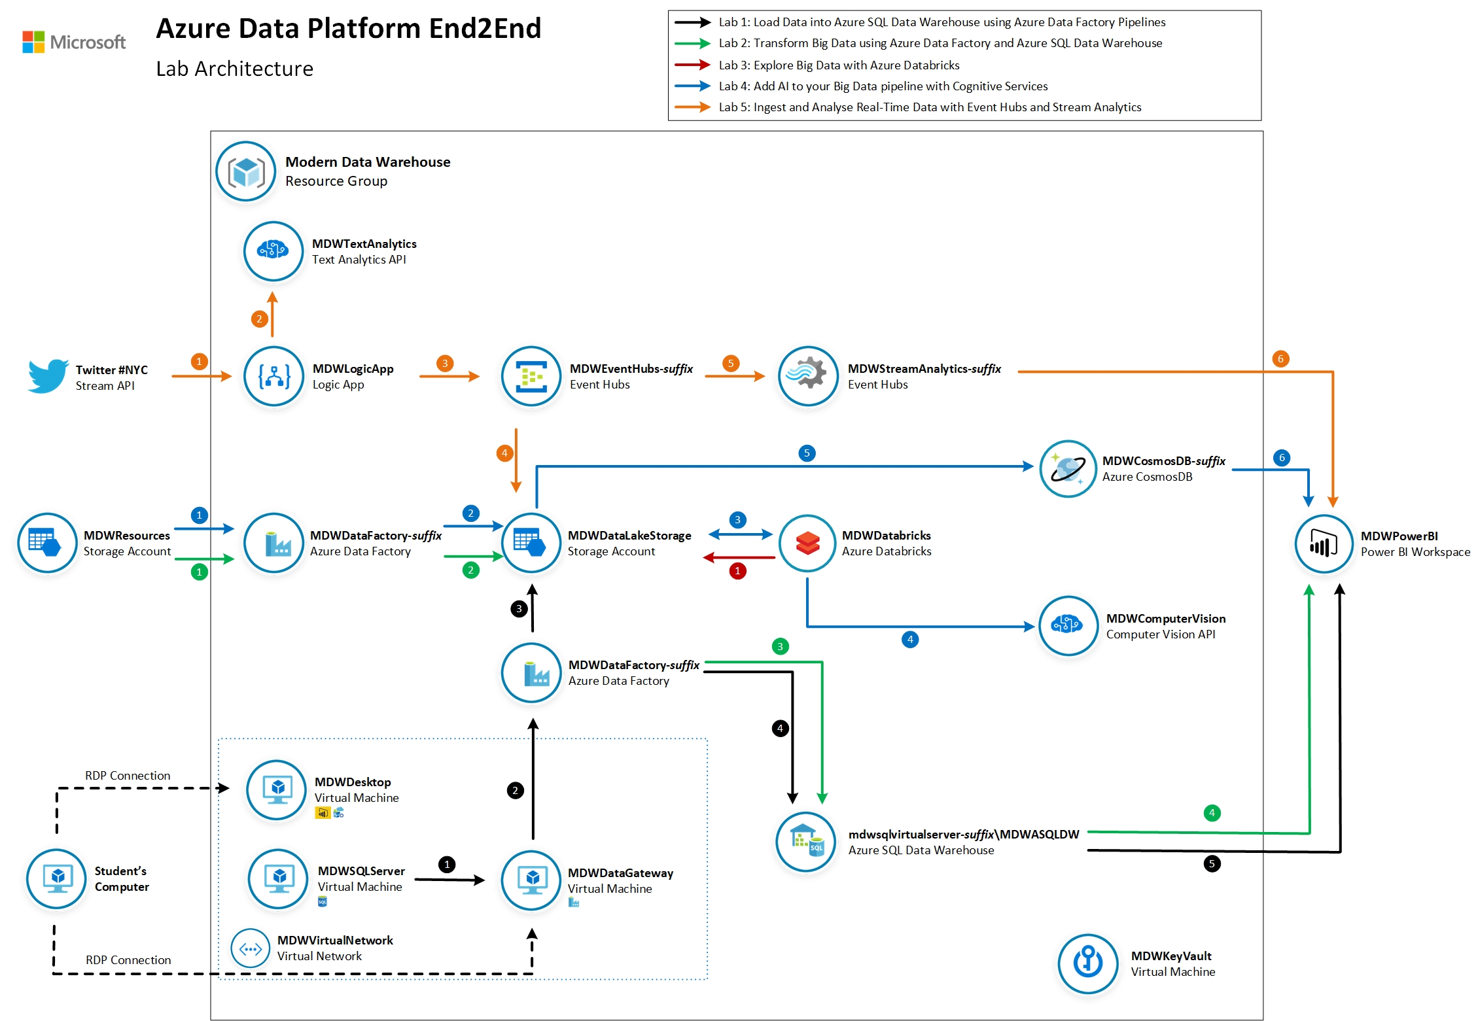
Lab Guide

Slide 7
The modern data world out there

Slide 8
I tried to understand it, but…
No-SQL
Databricks
Storm
Data Catalog
IoT
PaaS vs IaaS
Hadoop
Power BI
Streaming
Deep Learning
Machine Learning
SMP vs MPP
Predictive
Data Mart
ETL vs ELT
Prescriptive
Data Visualisation
Data Warehouse
Data Lake
Master Data
Big Data
Data Factory
Cloud vs On-prem
Data Quality
Velocity, Variety and Volume
Spark
AI
Semantic Layer

Slide 9
The modern data estate
LOB
CRM
Graph
Image
Social
IoT
Hybrid
Operational databases
Operational databases
Data warehouses
Data warehouses
Data lakes
Data lakes
Reason over any data, anywhere
Flexibility of choice
Security and performance

Slide 10
The Microsoft offering
LOB
CRM
Graph
Image
Social
IoT
Hybrid
Easiest lift and shift with no code changes
SQL Server
Azure Data Services
Industry leader 4 years in a row
Operational databases
Operational databases
70% faster
#1 TPC-H performance
Data warehouses
Data warehouses
2x the global reach
T-SQL query over any data
Data lakes
Data lakes
99.9% SLA
AI built-in | Most secure | Lowest TCO
Reason over any data, anywhere
Flexibility of choice
Security and performance
Notes:
Your data estate is your springboard for innovation.
these new products and services make up the Microsoft data platform
Our cloud-first approach means we work continuously to bring you:
reason over any data
Flexibility of choice
security and performance
Microsoft provides the best location for nurturing innovation today and into the future.
We’re investing in your success. So go ahead and work your magic.

Slide 11




The Azure data landscape
SQL
Azure Data Factory
Azure Import/Export service
Azure SQL DB
Azure Cosmos DB
Azure SQL data warehouse
Azure Analysis Services
Power BI
>_
Azure CLI
Azure SDK
10 01
Azure Blob Storage
Azure Data Lake Store
Azure HDInsight
Azure
Databricks
Azure ML
ML Server
Azure
Databricks
Azure IoT Hub
Azure event hubs
Azure Search
Azure Data Catalog
Azure Stream
Analytics
Azure HDInsight
Azure
Databricks
Bot service
Cognitive services
Kafka on Azure HDInsight
NSG
Azure ExpressRoute
Azure Active Directory
Azure network
security groups
Azure key
management service
Operations
Management Suite
Azure Functions
Visual Studio
Notes:
Explain that there is a number of data services available, each with their distinctive capabilities and use cases. No need to provide detailed explanation of each services as most of them will be covered in the following slides.

Slide 12


Our job, pretty much

Slide 13
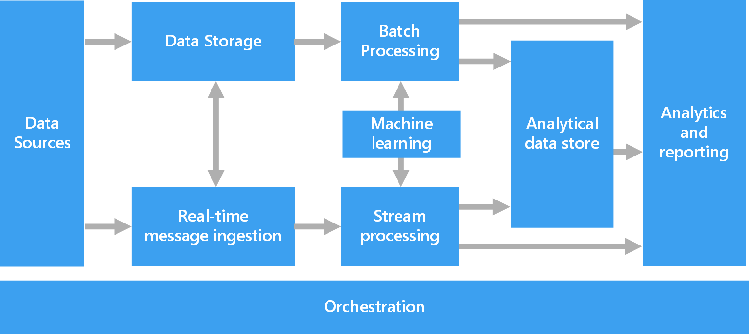
Azure Data Architecture Guide
Valuable collection of architecture principles to help you with your technology choices
https://aka.ms/adag

Slide 14
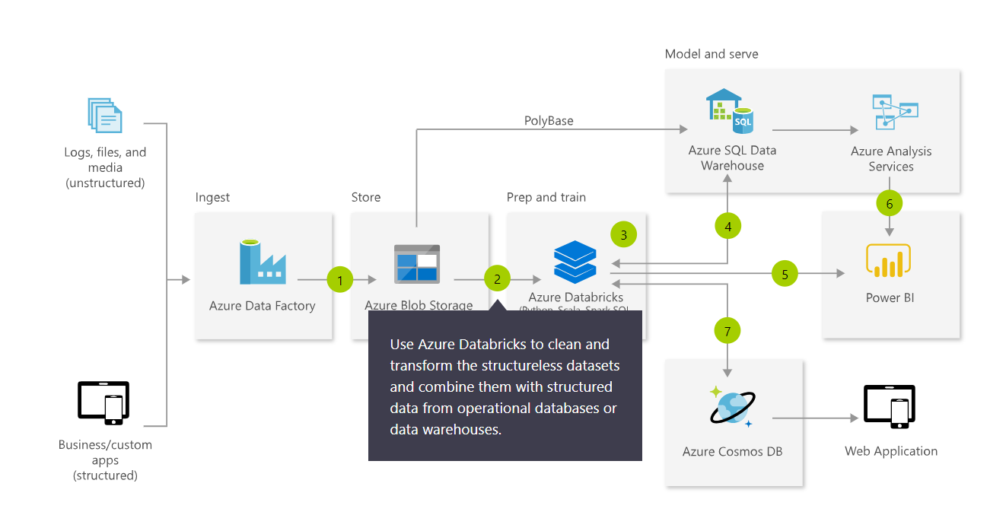
Azure Architecture Solutions
Collection of reference architectures for most common challenges
https://azure.microsoft.com/en-us/solutions/architecture/

Slide 15
Modern Data Platform Solution Scenarios
Big Data and advanced analytics
SQL
Modern data warehousing
Advanced analytics
Real-time analytics
“We want to integrate all our data—including Big Data—with our data warehouse”
“We’re trying to predict when our customers churn”
“We’re trying to get insights from our devices in real-time”

Slide 16
Modern Data Platform Concepts Part I

Slide 17
IaaS vs PaaS vs SaaS
On Premises
Physical / Virtual
Infrastructure
as a Service (IaaS)
Platform
as a Service (PaaS)
Software
as a Service (SaaS)
You manage
Applications
Applications
Applications
Applications
You scale, make resilient and manage
You scale, make
resilient & manage
Data
Data
Data
Data
Runtime
Runtime
Runtime
Runtime
Scale, Resilience and management by Microsoft
Middleware
Middleware
Middleware
Scale, Resilience and management by Microsoft
Middleware
O/S
O/S
O/S
O/S
Virtualization
Virtualization
Managed by Microsoft
Virtualization
Virtualization
Servers
Servers
Servers
Servers
Storage
Storage
Storage
Storage
Networking
Networking
Networking
Networking
Azure
Virtual Machines
Azure
Cloud Services

Slide 18
What is a Data Warehouse?
A data warehouse is a large collection of business data used to help an organization make decisions. Data in the Data Warehouse has been identified as valuable to specifically defined business cases and is stored in a structured way readily available for reporting and data analysis.
It is not a Database
Different workload types: transactional (DB) versus analytics (DW)
It is not a Data Lake
They are different, can co-exist and compliment each other
It is not a Data Mart
A data mart is a subject-oriented database populated from a subset of the Data Warehouse
Notes:
Characteristics

Slide 19
Modern Data Warehousing

Slide 20
Modern data warehousing
The modern data warehouse extends the scope of the data warehouse to serve Big Data that’s prepared with techniques beyond relational ETL
SQL
Modern data warehousing
Advanced analytics
Real-time analytics
“We want to integrate all our data—including Big Data—with our data warehouse”
“We’re trying to predict when our customers churn”
“We’re trying to get insights from our devices in real-time”

Slide 21
SQL Server and Azure SQL Database

Slide 22


Modernize on premises with SQL Server 2019 https://docs.microsoft.com/en-us/sql/sql-server/sql-server-technical-documentation
Now with big data clusters
Intelligence over any data
Choice of platform and language
Industry-leading performance
Most secure over the last 8 years⁵
Insights in minutes and rich reports
SQL
+
Analytics over structured and unstructured data with the power of SQL and Apache Spark
T-SQL
Java
C/C++
SCALA
Node.js
C#/VB.NET
Python
Ruby
.NET core
#1 OLTP performance¹
#1 DW performance on 1TB², 10TB³, and 30TB⁴
The best of Power BI and SQL Server Reporting Services in Power BI Report Server
In-memory across all workloads
Most consistent data platform
Private cloud
1/10th the cost of Oracle
Public cloud
All TPC Claims as of 1/19/2018.
¹ http://www.tpc.org/4081; ² http://www.tpc.org/3331; ³ http://www.tpc.org/3326; ⁴ http://www.tpc.org/3321; ⁵ National Institute of Standards and Technology Comprehensive Vulnerability Database
Notes:
Bob to cover
That’s not all it can do. SQL Server 2017 continues to deliver industry-leading capabilities:
Our latest performance benchmarks on Windows and Linux blow away our old records.
OLTP – We have #1 OLTP TPC-E performance
DW: And, we have the fastest performing DW. With best price/performance.
We offer the most secure database.
According to US National Institute of Standards and Technology (NSIT), we have had fewer vulnerabilities over the last 7 years than Oracle or IBM
Fewer vulnerabilities mean less patching for you!
SQL Server is the first commercial database with Advanced Analytics using R and Python built-in.
Why does this matter to you?
Now you can use SQL Server to operationalize your data science models in a secure and performant way
Use native T-SQL commands to score data in near real-time
And unlike our competitors, mobile BI on every device comes built-in. Or add access to powerful, self-service BI visualizations through Power BI - at a fraction of the cost of our competitors.
SQL Server 2017 gives you your choice of platform and language, and the most consistent on-prem to cloud environment.
And it does all this for 1/10th the cost of Oracle

Slide 23
Azure SQL Database https://docs.microsoft.com/en-us/azure/sql-database/
Azure SQL Database
Single
Elastic Pool
Managed Instance
Database-scoped deployment option with predictable workload performance
Shared resource model optimized for greater efficiency of multi-tenant applications
Instance-scoped deployment option with high compatibility with SQL Server and full PaaS benefits
Best for apps that require resource guarantee at database level
Best for SaaS apps with multiple databases that can share resources at database level, achieving better cost efficiency
Best for modernization at scale with low friction and effort
Notes:
Introducing Azure SQL Database Managed Instance
SQL Database Managed Instance is an expansion of the existing SQL Database service designed to enable database migration to a fully-managed database service, without re-designing the application.
It’s important to note that Managed Instance isn’t a new service – it is a third resource type within Azure SQL Database, sitting alongside single databases and elastic pools. As part of Azure SQL Database, Microsoft’s fully managed cloud database service, it inherits all its built-in features.
Each standalone database is assigned a certain amount of resources via performance tiers: Basic, Standard, and Premium. The emphasis of this offering focuses on a simplified database-scoped programming model and applications with a predictable pattern and relatively stable workload.
An elastic database pool is a shared resource model that enables higher resource utilization efficiency, and all the databases within an elastic pool share predefined resources within the same pool. The emphasis of this offering is on a simplified database-scoped programming model for multi-tenant SaaS apps. The workload pattern is well-defined and is highly cost-effective in multi-tenant scenarios. For ISVs with SaaS apps, the savings can be significant, in the hundreds of thousands of dollars or more.
A SQL Database Managed Instance offers a simplified instance-scoped programming model that is like an on-premises SQL Server instance. The databases in a SQL Database Managed Instance share the resources allocated to the Managed Instance, and the Managed Instance also represents the management grouping for these databases. The emphasis of this offering is on high compatibility with the programming model of an on-premises SQL Server and out-of-box support for a large majority of SQL Server features and accompanying tools/services.

Slide 24
Azure Data Factory

Slide 25




Azure Data Factory https://docs.microsoft.com/en-us/azure/data-factory/
Data Integration Service: Serverless, Scalable, Hybrid
Azure
Ent Apps & Data
SaaS
Clouds
Hybrid Pipeline Model
Seamlessly span: on prem, Azure, other clouds & SaaS
Run on-demand, scheduled, data-availability or on event
Data Movement @Scale
Cloud & Hybrid w/ 75+ connectors provided
Up to 1 GB/s
SSIS Package Execution
Lift existing SQL Server ETL to Azure
Use existing tools (SSMS, SSDT)
Author & Monitor
Programmability w/ multi-language SDK
Visual Tools

Slide 26
Azure SQL Data Warehouse

Slide 27
Azure SQL Data Warehouse https://docs.microsoft.com/en-us/azure/sql-data-warehouse/
Best in class
price-performance
Industry-leading security
Intelligent workload management
Data flexibility
Developer productivity
Up to 14X times faster and 94% less expensive than cloud competitors
Defense-in-depth security and 99.9% financially backed availability SLA
Separation of compute and storage
Prioritize resources for the most valuable workloads
Query directly over the Data Lake
Support for structured and semi-structured data
Enterprise class application lifecycle management

Slide 28
Lab 1: Load data into Azure SQL Data Warehouse using Azure Data Factory Pipelines

Slide 29
Lab 1
Relational Data Sources

Slide 30
Lab 1
Lab Architecture

Slide 31
Modern Data Platform Concepts Part II

Slide 32
What is a Data Lake?
It is a central storage repository that holds data coming from many sources in a raw, granular format. It can store structured, semi-structured, or unstructured data, which means data ingested quickly and can be kept in a more flexible format for future use cases.
Characteristics
Schema-on-read (ELT)
Collection of data, not a platform
Benefits
Quickly ingest high volumes of diverse data structures
Enable advanced analytics and data exploration
Scalability and storage cost reduction
Best Practices
Data Governance needed to avoid Data Swamp
Security considerations
Perfect place for evolving data
Design your Data Lake
Metadata management
Notes:
Characteristics

Slide 33
Data Warehouse or Data Lake?
Answer: both.
 | Data Warehouse | Data Lake
Requirements | Relational requirements | Diverse data, scalability, low cost
Data Value | Data of recognised high value | Candidate data of potential value
Data Processing | Mostly refined calculated data | Mostly detailed source data
Business Entities | Known entities, tracked over time | Raw material for discovering entities and facts
Data Standards | Data conforms to enterprise standards | Fidelity to original format and condition
Data Integration | Data integration upfront | Data prep on demand
Transformation | Data transformed, in principle | Data repurposed later, as needs arise
Schema Definition | Schema-on-write | Schema-on-read
Metadata Management | Metadata improvement | Metadata developed on read

Slide 34
Data Lake Design Considerations
Data Lake Zones
Transient Landing Zone
Temporary storage of data to meet regulatory and quality control requirements. Limited access. May not be required depending on requirements.
Raw Zone
Original source of data ready for consumption. Metadata publicly available but access to data still limited.
Trusted Zone
Standardized and enriched datasets ready for consumption to those with appropriate role-based access. Metadata available to all.
Curated/Refined Zone
Data transformed from Trusted Zone to meet specific business requirements.
Sandbox Zone
Playground for Data Scientists for ad hoc exploratory use cases.
Data Governance Considerations
Security and Compliance
Access Control
Encryption
Row-Level Security
Metadata Management
Data Quality
Metadata Management
Lifecycle Management

Slide 35
Azure Data Lake Storage Gen2

Slide 36

Azure Data Lake Storage Gen2 https://docs.microsoft.com/en-us/azure/storage/blobs/data-lake-storage-introduction
High performance HDFS Endpoint to Azure Blob Storage
Blob API
Gen2 API
Unstructured Object Data
File Data
Server Backups, Archive Storage, Semi-structured Data
Hadoop File System, File and Folder Hierarchy, Granular ACLS Atomic File Transactions
Common Blob Storage Foundation
Object Tiering and Lifecycle Policy Management
AAD Integration, RBAC, Storage Account Security
HA/DR support through ZRS and RA-GRS
* Full Blob and HNS Interoperability available in post-GA

Slide 37
Lab 2: Transform Big Data using Azure Data Factory and Azure SQL Data Warehouse

Slide 38
Lab 2
Semi-Structured Data Sources

Slide 39
Lab 2
Lab Architecture

Slide 40
Advanced Analytics

Slide 41
Advanced analytics
Advanced analytics goes beyond the traditional business intelligence (BI) and uses mathematical, probabilistic, and statistical modeling techniques to enable predictive processing and automated decision making.
SQL
Modern data warehousing
Advanced analytics
Real-time analytics
“We want to integrate all our data—including Big Data—with our data warehouse”
“We’re trying to predict when our customers churn”
“We’re trying to get insights from our devices in real-time”

Slide 42
Modern Data Platform Concepts Part III

Slide 43


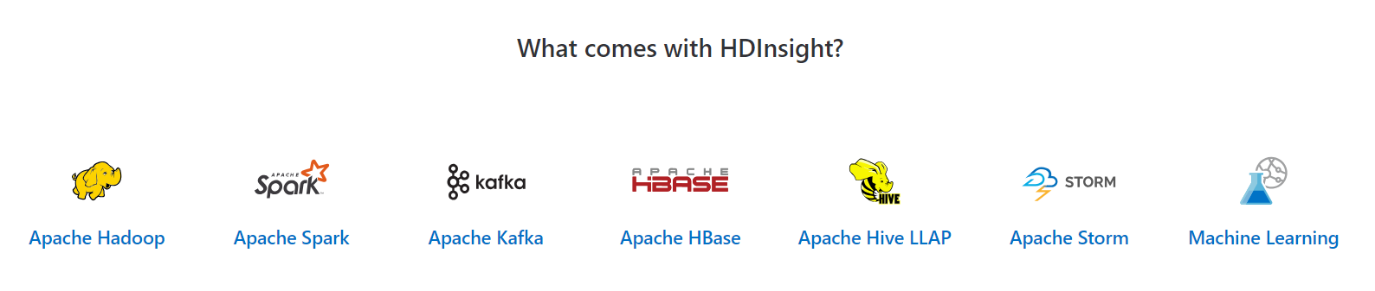
Hadoop and Spark in Azure
Open Source Apache Projects for Big Data Compute
It was the original open-source framework for distributed processing and analysis of big data sets on clusters.
Read/write from disk.
Economical batch mode.
Linear processing of huge datasets.
Effective, fast, general-purpose unified cluster computing framework with high-level APIs in Java, Scala, Python and R.
In-memory processing.
Fast, interactive data processing.
Streaming and Machine Learning Support
Azure HDInsight is a managed, full-spectrum, open-source analytics service for enterprises

Slide 44
Apache Spark Value Proposition
Performance
Run programs up to 100x faster than Hadoop MapReduce in memory
10x faster on disk
Useful for real-time and batch processing
Productivity
Write applications quickly in Scala or Python, Java
Over 80 high-level operators that make it easy to build parallel apps
Use interactively from the Scala and Python shells
Unified and integrated analytics model
Includes higher-level libraries in integrated framework
Combine SQL, streaming, graph processing
Runs on Hadoop (Yarn, Mesos), standalone, or in the cloud
Diverse data sources including HDFS (CSV, JSON, etc.), Azure Storage, Cosmos DB, Azure SQL Data Warehouse, Parquet, JDBC
Open
Apache Project
Contributors: 50 companies and over 400 developers, growing

Slide 45
Azure Databricks

Slide 46
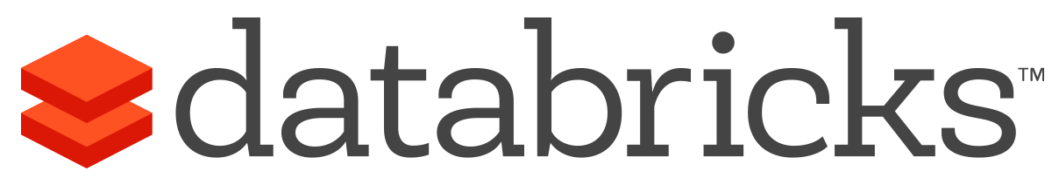


Azure Databricks https://docs.microsoft.com/en-us/azure/azure-databricks/
A fast, easy and collaborative Apache® Spark™ based analytics platform optimized for Azure
Best of Databricks
Best of Microsoft
Designed in collaboration with the founders of Apache Spark
One-click set up; streamlined workflows
Interactive workspace that enables collaboration between data scientists, data engineers, and business analysts.
Native integration with Azure services (Power BI, SQL DW, Cosmos DB, ADLS, Azure Storage, Azure Data Factory, Azure AD, Event Hub, IoT Hub, HDInsight Kafka, SQL DB)
Enterprise-grade Azure security (Active Directory integration, compliance, enterprise-grade SLAs)

Slide 47
Azure Databricks
Azure Databricks
Collaborative Workspace
IoT / streaming data
Machine learning models
DATA ENGINEER
DATA SCIENTIST
BUSINESS ANALYST
Deploy Production Jobs & Workflows
Cloud storage
BI tools
MULTI-STAGE PIPELINES
JOB SCHEDULER
NOTIFICATION & LOGS
Data warehouses
Optimized Databricks Runtime Engine
Data exports
Hadoop storage
DATABRICKS I/O
APACHE SPARK
SERVERLESS
Rest APIs
Data warehouses
Enhance Productivity
Build on secure & trusted cloud
Scale without limits

Slide 48
Lab 3: Explore Big Data with Azure Databricks

Slide 49
Lab 3
Semi-Structured Data Sources

Slide 50
Lab 3
Lab Architecture

Slide 51
Modern Data Platform Concepts Part IV

Slide 52
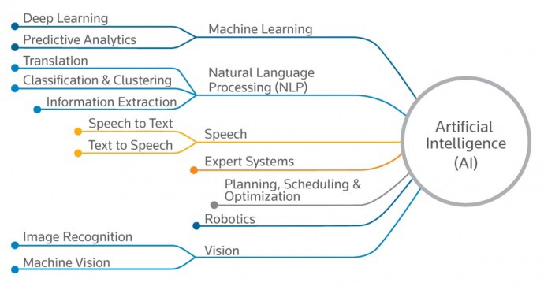
Artificial Intelligence
“The ability of a digital computer or computer-controlled robot to perform tasks commonly associated with intelligent beings.” – Encyclopedia Britannica
Machine Learning
Supervised Learning
Regression
Classification
Unsupervised Learning
Cluster Analysis
Application Examples
Weather Forecast
Fraud Detection
Customer Churn
Insurance Premium

Slide 53
What’s No-SQL?
Term coined in 2009 for a developer meetup – ”Not Only SQL” -> “NoSQL”.
Databases that allow you to store and retrieve data in various structures, formats, and models other than tabular relational model.
There’s a time and a place for everything
Sometimes a relational store is the right choice
Sometimes a NoSQL store is the right choice
Sometimes you need more than one store for an app -> polyglot persistence
Data Structures
Key-Value Databases
Redis Cache, Azure Table
Column Family Stores
Cosmos DB, Cassandra, HBase
Graph Databases
Cosmos DB, Neo4j, Gremlin
Document Databases
Cosmos DB, MongoDB

Slide 54
Microsoft AI

Slide 55
The Microsoft AI platform: Azure & AI
Option 1: High level intro
Services
Tools
Infrastructure
Notes:
It’s all about three pieces: our Azure services, our infrastructure, and our tools.

Slide 56
Option 2: Detailed intro
Microsoft AI Platform
Azure AI Services
PRE-BUILT AI
CONVERSATIONAL AI
CUSTOM AI
CODING & MANAGEMENT TOOLS
Cognitive Services
Tools
Bot Service
Azure Machine Learning
VS Tools for AI
Azure ML Studio
Azure ML Workbench
Others (PyCharm, Jupyter Notebooks…)
Azure Infrastructure
DEEP LEARNING FRAMEWORKS
AI ON DATA
AI COMPUTE
3rd Party
Cosmos DB
SQL
DB
SQL
DW
Data Lake
Spark
DSVM
Batch AI
ACS
IoT Edge
Cognitive Toolkit
TensorFlow
Caffe
CPU, FPGA, GPU
Others (Scikit-learn, MXNet, Keras, Chainer, Gluon…)
Notes:
Let’s start with AI services. We provide the most comprehensive set of AI services for any developer, any organization, and any scenario.
We have pre-built AI services with Cognitive Services. We were the first ones in the market to release this concept of AI as a service, and we are leaders in terms of developer adoption, number of services and capabilities provided. We have the unique capability for developers to customize these services for any particular scenario, something our competitors are only in the very early stages of.
We also have the most powerful bot platform, fully integrated with these services, enabling organizations to embrace conversational AI and connect them with their business processes.
And finally, we also provide a full solution for custom AI with Azure Machine Learning, covering the entire lifecycle of AI development in the Enterprise, from training to deployment.
All of this is based on the powerful infrastructure provided by Azure. We are taking all that power and applying it to AI, from CPU compute to GPU and next, FPGA.
We have a huge lever in the market with our tools. We’re taking the power of Visual Studio and Visual Studio Code to AI development. We are unique in our ability to provide a full solution across services and tools to make AI development productive and approachable.
Every developer can be an AI developer with this unique combination.
Lastly, we take an open approach to this solution. These tools and services work across any framework, we don’t make the decision for you, so you are not locked in to a vendor.

Slide 57







Microsoft Cognitive Services
Give your apps a human side
Vision
From faces to feelings, allow your apps to understand images and video
Speech
Hear and speak to your users by filtering noise, identifying speakers, and understanding intent
Language
Process text and learn how to recognize what users want
Knowledge
Tap into rich knowledge amassed from the web, academia, or your own data
Search
Access billions of web pages, images, videos, and news with the power of Bing APIs
Labs
An early look at emerging Cognitive Services technologies: discover, try and give feedback on new technologies before general availability

Slide 58
Microsoft Cognitive Services
Give your apps a human side
Computer Vision
Content Moderator
Emotion
Face
Video Indexer
Custom Vision Service
Bing Speech
Speaker Recognition
Custom Speech Service
Bing Spell Check
Linguistic Analysis
Text Analytics
Translator Text & Speech
Web Language Model
Language Understanding
Academic Knowledge
Entity Linking
Knowledge Exploration
Recommendations
QnA Maker
Custom Decision Service
Bing Autosuggest
Bing Image Search
Bing News Search
Bing Video Search
Bing Web Search
Bing Entity Search
Bing Custom Search
Project Prague (gesture)
Project Cuzco (events)
Project Johannesburg (routing)
Project Nanjing (isochrones)
Project Abu Dhabi (distance matrix)
Project Wollongong (location)
Vision
Speech
Language
Knowledge
Search
Labs

Slide 59
Microsoft Cognitive Services
Give your apps a human side
Vision
Speech
Language
Knowledge
Search
Labs
Computer Vision
Content Moderator
Emotion
Face
Video Indexer
Bing Speech
Speaker Recognition
Bing Spell Check
Linguistic Analysis
Text Analytics
Translator Text & Speech
Web Language Model
Academic Knowledge
Entity Linking
Knowledge Exploration
Recommendations
QnA Maker
Bing Autosuggest
Bing Image Search
Bing News Search
Bing Video Search
Bing Web Search
Bing Entity Search
Project Prague (gesture)
Project Cuzco (events)
Project Johannesburg (routing)
Project Nanjing (isochrones)
Project Abu Dhabi (distance matrix)
Project Wollongong (location)
CUSTOMIZATION
Custom Vision Service
Custom Speech Service
Language Understanding
Custom Decision Service
Bing Custom Search

Slide 60
Cosmos DB

Slide 61



Azure Cosmos DB https://docs.microsoft.com/en-us/azure/cosmos-db/
A globally distributed, massively scalable, multi-model database service
SQL
MongoDB
Table API
Column-family
Document
Key-value
Graph
Guaranteed low latency at the 99th percentile
Elastic scale out
of storage & throughput
Five well-defined consistency models
Turnkey global distribution
Comprehensive SLAs

Slide 62
Lab 4: Add AI to your Big Data Pipeline with Cognitive Services

Slide 63
Lab 4
Non-Structured Data Sources

Slide 64
Lab 4
Lab Architecture

Slide 65
Real-time Analytics

Slide 66
Real-time analytics
Deals with streams of data that are captured in real-time and processed with minimal latency to generate real-time (or near-real-time) reports or automated responses.
SQL
Modern data warehousing
Advanced analytics
Real-time analytics
“We want to integrate all our data—including Big Data—with our data warehouse”
“We’re trying to predict when our customers churn”
“We’re trying to get insights from our devices in real-time”

Slide 67
Modern Data Platform Concepts Part V

Slide 68

Unlocking Real-time Insights
Time to Insight is Critical
Reducing decision latency can unlock business value
Insights are Perishable
Window of opportunity for insights to be actionable
Ask Questions to Data in Motion
Can’t wait for data to get to rest before running computation

Slide 69







Streaming Use Cases
Retail
Financial
Oil/Gas & Energy
Security
CONSUMER ENGAGEMENT
RISK AND REVENUE MANAGEMENT
GRID OPS, ASSET OPTIMIZATION
ACTIONABLE THREAT INTELLIGENCE
Real-time Pricing Optimization
Risk and Fraud, Threat Detection
Industrial IoT
Security Intelligence
Demand-Elasticity
Personal Pricing Schemes
Promotion events
Multi-channel engagement
Real-time anomaly detection
Card Monitoring and Fraud Detection
Risk Aggregation
Preventive Maintenance
Smart Grids and Microgrids
Asset performance as a Service
UAV image analysis
Real-time firewall, network, and auth log correlation
Anomaly detection
Security context, enrichment
Security Orchestration
Healthcare
Advertising
Media Entertainment
SENSOR DATA
RECOMMENDATION ENGINE
CONSUMER ENGAGEMENT ANALYSIS
And Much More!
IoT DEVICE
ANALYTICS
Next Best and Personalized Offers
Sentiment Analysis
Aggregation of streaming events
Predictive Maintenance
Anomaly Detection
Right product, promotion, at right time
Real time Ad bidding platform
Personalized Ad Targeting
Demand-Elasticity
Social Network Analysis
Promotion events
Multi-channel Attribution

Slide 70
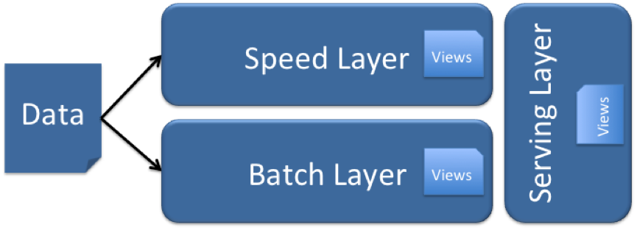
Lambda (λ) Architecture
Designed to handle Big Data use cases by taking advantage of both batch and stream-processing methods
All data entering the system is dispatched to both the batch layer and the speed layer for processing.
The batch layer has two functions:
manage the master dataset (an immutable, append-only set of raw data)
pre-compute the batch views.
The serving layer indexes the batch views so that they can be queried in low-latency, ad-hoc way.
The speed layer compensates for the high latency of updates to the serving layer and deals with recent data only.
Any incoming query can be answered by merging results from batch views and real-time

Slide 71
Event Hubs

Slide 72

Event Hubs https://docs.microsoft.com/en-us/azure/event-hubs/
Big data streaming platform and event ingestion service capable of receiving and processing millions of events per second.

Slide 73
Stream Analytics

Slide 74
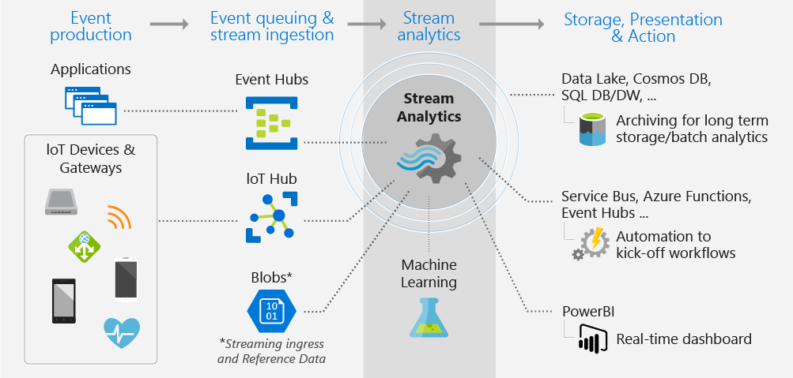
Stream Analytics https://docs.microsoft.com/en-us/azure/stream-analytics/
Event-processing engine that allows you to examine high volumes of data streaming from devices

Slide 75
Lab 5: Ingest and Analyse real-time data with Event Hubs and Stream Analytics

Slide 76
Lab 5
Stream

Slide 77
Lab 5
Lab Architecture

Slide 78
It’s all on
Notes:
With Azure, you can be more productive. Azure has more than 100 services with great end-to-end tools to make you successful.
Develop and deploy where you want, with the only consistent hybrid cloud on the market. Extend Azure on-premises with Azure Stack.
Create intelligent apps using powerful data and AI services.
Develop with confidence on the trusted cloud.
<Transition>: Join startups, governments, and 90% of Fortune 500 businesses who run on the Microsoft Cloud today.

